Slide 1
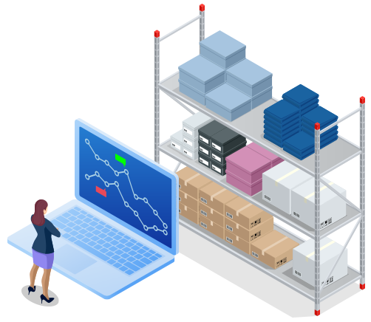
INVENTORY CONTROL

Slide 2
Learning Outcome
Comprehend the dynamics of inventory management concepts, and techniques as they relate to the entire supply chain

Slide 3
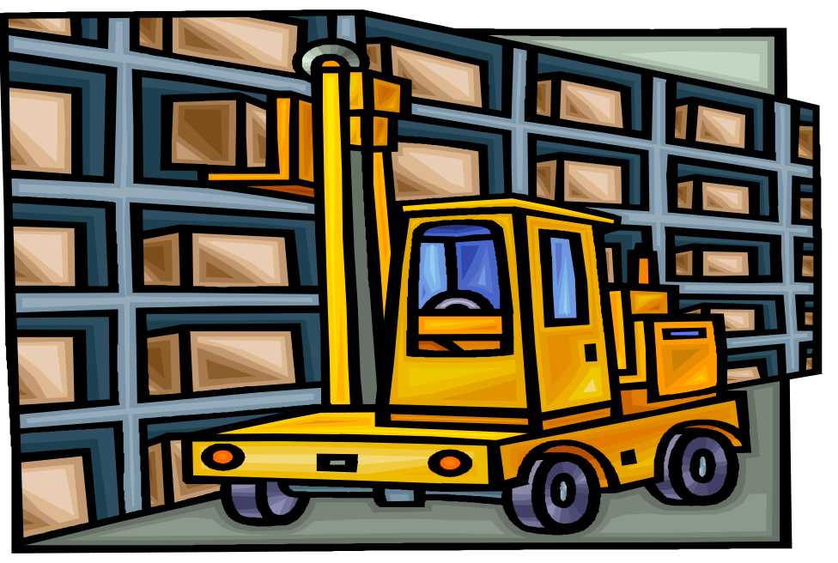
INVENTORY
Held for SALE
Consumed in the PRODUCTION of goods/services

Slide 4

Forms of Inventory
Raw materials
Work in process
Finished goods

Slide 5
Inventory Management- Objectives
Availability of Inventory
No excessive investment.
Reasonable price
No risk of spoilage and obsolescence
Misappropriation of material.

Slide 6
INVENTORY COSTS
Carrying cost
  cost of holding an item in inventory
Ordering cost
  cost of replenishing inventory
Shortage cost
  temporary or permanent loss of sales when demand cannot be met

Slide 7
RISK OF HOLDING INVENTORY
Price decline
Product Deterioration
Product Obsolescence

Slide 8
TOOLS & TECHNIQUES OF INVENTORY MANAGEMENT/ CONTROL
ABC Analysis
Economic Ordering Quantity (EOQ)
Stock Levels
Just In Time (JIT)

Slide 9

ABC-Always better control
Money value of consumption
Notes:
Basic analytical managementtolol which enables the place efforts where results shall be greatest

Slide 10

ABC TECHNIQUE (Selective Control )
Materials are analysed according to their value so that costly and more valuable materials are given greater attention and care.
‘A’ Items (Significant few) :
-High value items which may consist of only a small % of the total items.
-Should be under the tightest control on account of their high cost.
-Requires high responsibility.
‘B’ Items (Not few, not too many):
-Neither very cheap nor very costly.
-Should be under the normal control procedures.
‘C’ Items (Insignificant many):
-Low value materials which represent a very large number of items.
-Should be under simple and economical methods of control.

Slide 11
ABC Analysis
CATEGORY | NO. OF ITEMS(%) | ITEM VALUE(%) | MANAGEMENT CONTROL
A | 15 | 70 (HIGHEST) | MAXIMUM
B | 30 | 20 (MODERATE) | MODERATE
C | 55 | 10 (LEAST) | MINIMUM
TOTAL | 100 | 100

Slide 12
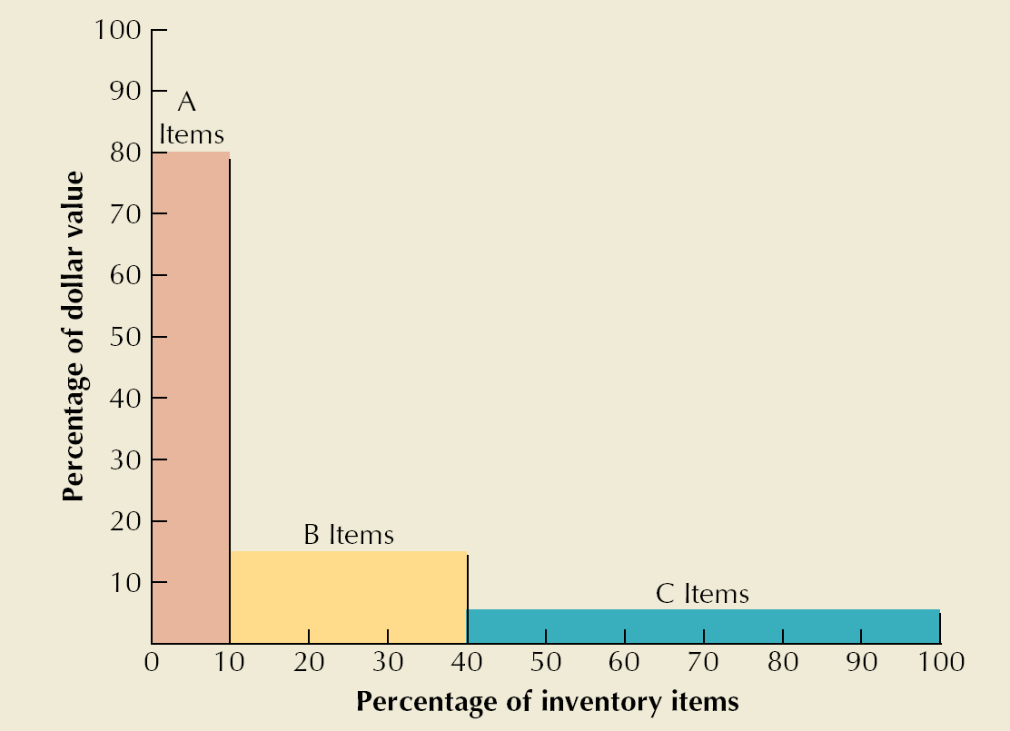

Slide 13
Economic Ordering Quantity (EOQ)

Slide 14
Economic Ordering Quantity (EOQ)
Level of Inventory at which
Total Cost* of Inventory is MINIMUM
*(Ordering and Carrying Cost)

Slide 15
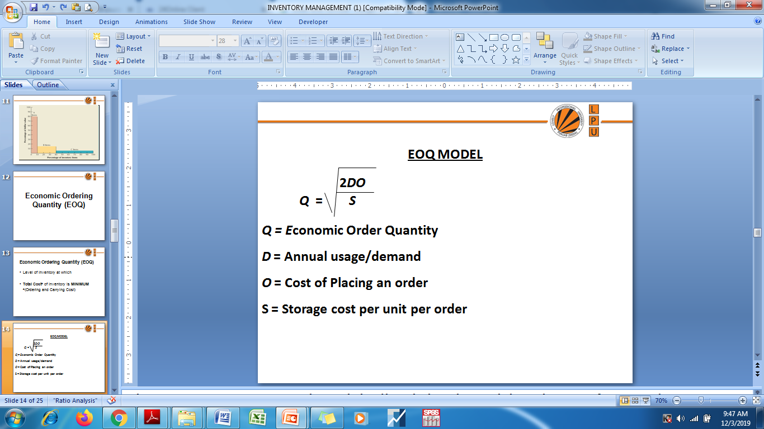
Notes:
Where Storage cost is given in % , it is always calculated by multiplying the % with the purchase price of raw material per unit, i.e Storage cost = % X Purchase price of raw material

Slide 16
EOQ- Example
A firm’s annual inventory is 1,600 units. The cost of placing an order is Rs 50, purchase price of raw material/unit is Rs.10 and the carrying costs is expected to be 10% per unit p.a. Calculate EOQ?
Solution:
U=1600, P= Rs. 50, S= .10 x Rs.10=Rs.1
EOQ = 2 x 1600 x 50
1
= 400 units

Slide 17
EXAMPLE
Annual usage -6000
cost of placing order- Rs 30
Carrying cost -20%
Cost per unit of material- Rs 5
Find EOQ?

Slide 18
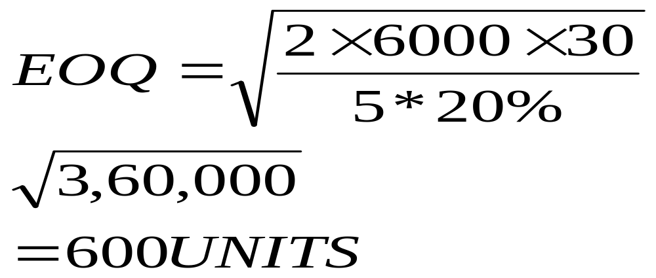
SOLUTION

Slide 19

Question
Find the Economic Order Quantity from the following data:

Slide 20
Solution
EOQ = √2AB/CS
= √2 × 18,000 × 12 × 100/1.50 × 20
√4,32,00,000/30
= √14,40,000 = 1,200 units

Slide 21
Question
A manufacturer uses 200 units of a component every month and he buys them entirely from outside supplier. The order placing and receiving cost is Rs.100 and annual carrying cost is Rs.12. From this set of data calculate the Economic Order Quantity.

Slide 22
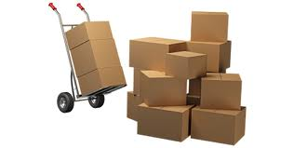
STOCK LEVELS

Slide 23



In order to guard against under-stocking and over-stocking, most of the large companies adopt a scientific approach of fixing stock levels. These levels are: (i) maximum level; (ii) minimum level; (iii) reorder level; and (iv) reorder quantity. By adhering to these levels, each item of material will automatically be held within appropriate limits of control.
Maximum
Level
Minimum Level
Reorder Level or Ordering Level
Average Stock Level

Slide 24
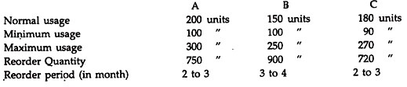
Question
P. Ltd. uses three types of materials A, B & C for production of X, the final product.
The relevant monthly data for the components are as given below:
Calculate for each component:
(a) Re-order level
(b) Minimum level
(c) Maximum level
(d) Average stock level

Slide 25
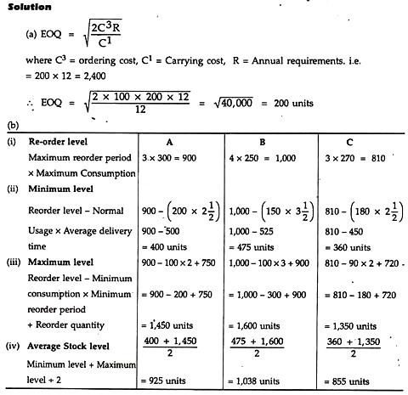

Solution

Slide 26
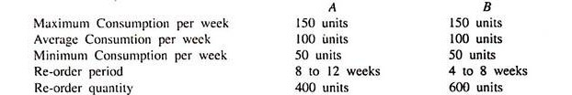
Question
Compute the re-order level, minimum level, maximum level, average stock level for components A and B based on the following data:

Slide 27
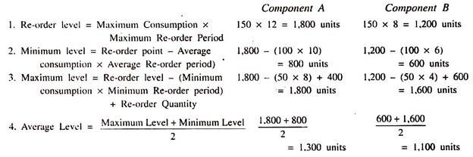
Solution

Slide 28
Question
In a factory component A is used as follows:
Normal usage – 50 kg per week
Minimum usage – 25 kg per week
Maximum usage – 75 kg per week
Re-order quantity 300 kg.
Re-order period 4 to 6 weeks.
Calculate for component A:
(i) Re-order level,
(ii) Maximum level.
(iii) Minimum level; and
(iv) Average stock level.

Slide 29
Solution
(i) Re-order level = Maximum usage × Maximum period
= 75 × 6 = 450 kg
(ii) Maximum level = Re-order level + Re-order quantity – (Minimum usage × Minimum time)
= 450 + 300 – (25 × 4) = 650 kg.
(iii) Minimum level = Reorder level – (Normal usage × Average time)
= 450 – (50 × 5) = 200 kg.
(iv) Average stock level = Maximum level + Minimum level/2
= (650 + 200/2)kg = 425 kg.

Slide 30
JUST-IN-TIME (JIT)

Slide 31
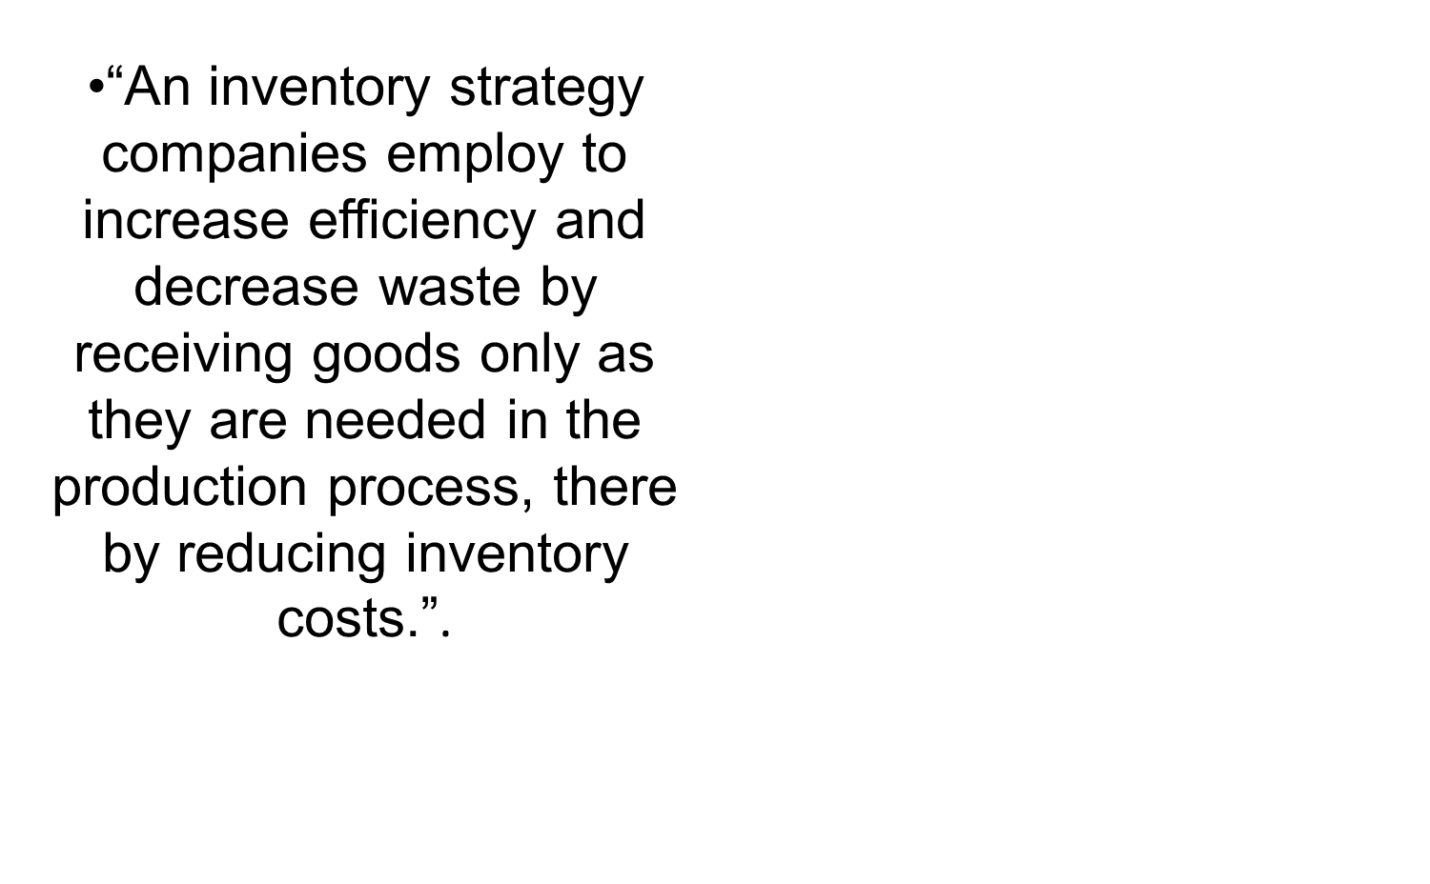
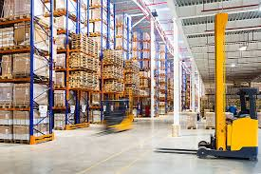

Slide 32


Slide 33


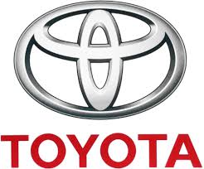
Notes:
1) Toyota is considered by many to be the poster child for JIT success. The Toyota Production Strategy is highlighted by the fact that raw materials are not brought to the production floor until an order is received and this product is ready to be built. No parts are allowed at a node unless they are required for the next node, or they are part of an assembly for the next node. This philosophy has allowed Toyota to keep a minimum amount of inventory which means lower costs.
2) Harley-Davidson successfully adopted Japanese manufacturing principles which many considered were impossible for US manufacturers to achieve because of cultural and political reasons. • After implementing these Japanese techniques, Harley-Davidson succeeded in manufacturing high quality motorcycles at lower cost.It witnessed the success of JIT in the late 1980s. • Achieved inventory turnover from 5 to 20, reduced the inventory by 75%
3) Dell has also leveraged JIT principles to make its manufacturing process a success. • Dell’s approach to JIT is different in that they leverage their suppliers to achieve the JIT goal. • They are also unique in that Dell is able to provide exceptionally short lead times to their customers, by forcing their suppliers to carry inventory instead of carrying it themselves and then demanding (and receiving) short lead times on components so that products can be simply assembled by Dell quickly and then shipped to the customer.

Slide 34
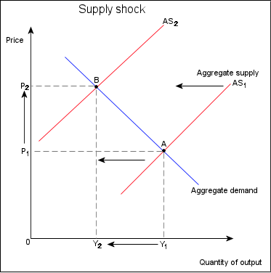
DISADVANTAGES OF JIT
IMPLEMENTATION
JIT operation leaves suppliers and downstream consumers open to Supply Shocks
The organization will not be able to cater to large orders on time.

Slide 35
QuiZ!!

Slide 36
MCQ
Which of the following is not an inventory?
Machines
Raw material
Finished products
Consumable tools
Notes:
A

Slide 37
MCQ
‘Buffer stock’ is the level of stock
Half of the actual stock
At which the ordering process should start
Minimum stock level below which actual stock should not fall
Maximum stock in inventory
Notes:
C

Slide 38
MCQ
The minimum stock level is calculated as
Reorder level – (Normal consumption x Normal delivery time)
Reorder level + (Normal consumption x Normal delivery time)
(Reorder level + Normal consumption) x Normal delivery time
(Reorder level + Normal consumption) / Normal delivery time
Notes:
A

Slide 39
MCQ
Which of the following is true for Inventory control?
Economic order quantity has minimum total cost per order
Inventory carrying costs increases with quantity per order
Ordering cost decreases with lo size
All of the above
Notes:
D

Slide 40
Re-ordering level is calculated as
Maximum consumption rate x Maximum re-order period
Minimum consumption rate x Minimum re-order period
Maximum consumption rate x Minimum re-order period
Minimum consumption rate x Maximum re-order period
Notes:
A

Slide 41
Thank You!!

